Slide 1



CHURCH, HOME, AND COMMUNITY
Holistic Discipleship with Children

Slide 2

Mark 10:13-16
People were bringing little children to Jesus for him to place his hands on them, but the disciples rebuked them. When Jesus saw this, he was indignant. He said to them, “Let the little children come to me, and do not hinder them, for the kingdom of God belongs to such as these. Truly I tell you, anyone who will not receive the kingdom of God like a little child will never enter it.” And he took the children in his arms, placed his hands on them and blessed them.

Slide 3
Mark 10:13-16
People were bringing little children to Jesus for him to place his hands on them, but the disciples rebuked them. When Jesus saw this, he was indignant. He said to them, “Let the little children come to me, and do not hinder them, for the kingdom of God belongs to such as these. Truly I tell you, anyone who will not receive the kingdom of God like a little child will never enter it.” And he took the children in his arms, placed his hands on them and blessed them.

Slide 4
Mark 10:13-16
People were bringing little children to Jesus for him to place his hands on them, but the disciples rebuked them. When Jesus saw this, he was indignant. He said to them, “Let the little children come to me, and do not hinder them, for the kingdom of God belongs to such as these. Truly I tell you, anyone who will not receive the kingdom of God like a little child will never enter it.” And he took the children in his arms, placed his hands on them and blessed them.

Slide 5





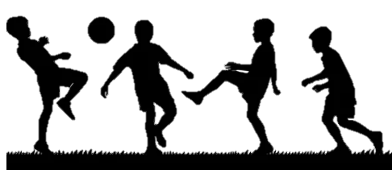


Slide 6

Where do you think this child’s faith is most shaped during the week?

Slide 7
Deuteronomy 6:6-7
These commandments that I give you today are to be on your hearts. Impress them on your children. Talk about them when you sit at home and when you walk along the road, when you lie down and when you get up.

Slide 8
CHURCH

Slide 9
What is one way children participate in church life in your context?

Slide 10
CHURCH
HOME

Slide 11
CHURCH
HOME

Slide 12
One assumptions our church might have about faith at home
One way home life reality might look different than our assumption

Slide 13
CHURCH
HOME
COMMUNITY

Slide 14
CHURCH
HOME
COMMUNITY

Slide 15
CHURCH
HOME
COMMUNITY

Slide 16
How might the places children spend time during the week — school, sport, friendships — shape their faith?

Slide 17
If Sunday gatherings didn’t exist for a while, where do you think children in your church would still encounter faith?

Slide 18
CHURCH
HOME
COMMUNITY

Slide 19

On your diagram, note down:
What is happening in each space in your context?
Where you see connections between them?
In groups compare what you noticed:
Which space receives the most energy in your church?
Which space probably has the most influence on children?
Where do you see strong connections?
Where are the gaps or weak connections?

Slide 20
What is the most surprising thing you noticed when you mapped this?
What connections are strong?
What connections are missing?

